Slide 1


Sign Language
Detection
System

Slide 2
01
Introduction
02
Model Specifics
AGENDA
03
System Overview
04
Results & Applicability

Slide 3
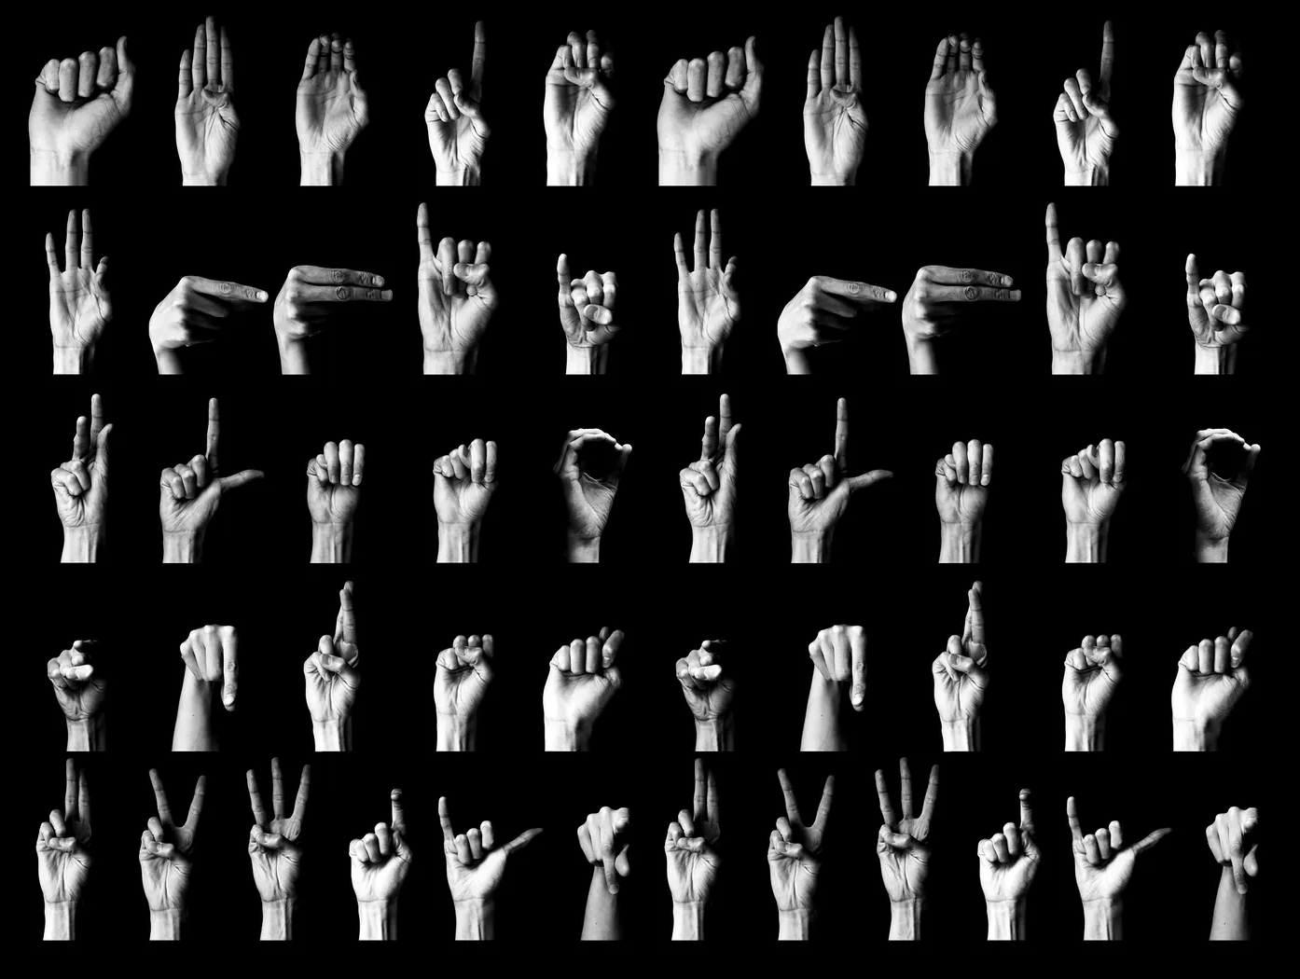
01
Introduction

Slide 4

Technology & Accessibility

Slide 5
OpenCV : Open Source Computer Vision Library is a powerful library for computer vision and image processing tasks
Webcam Access
Image Frame Processing
Real Time Detection
LabelImg : LabelImg is a graphical image annotation tool that allows users to label objects in images for training object detection models.
02
Model Specifics

Slide 6
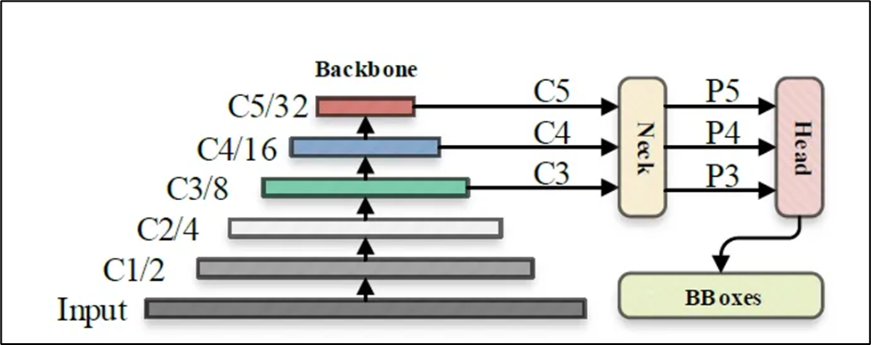

Backbone
Feature Extraction
CNN
Trained on Imagenet
Neck
Fuse Features from different scales
Convolution Layer
Spatial Pyramid Pooling
Small Objects
Head
Predicting Bounding Boxes and
Class Probabilities
Series of Convolution Layer
Final Prediction Layer

Slide 7
03
System Overview

Slide 8
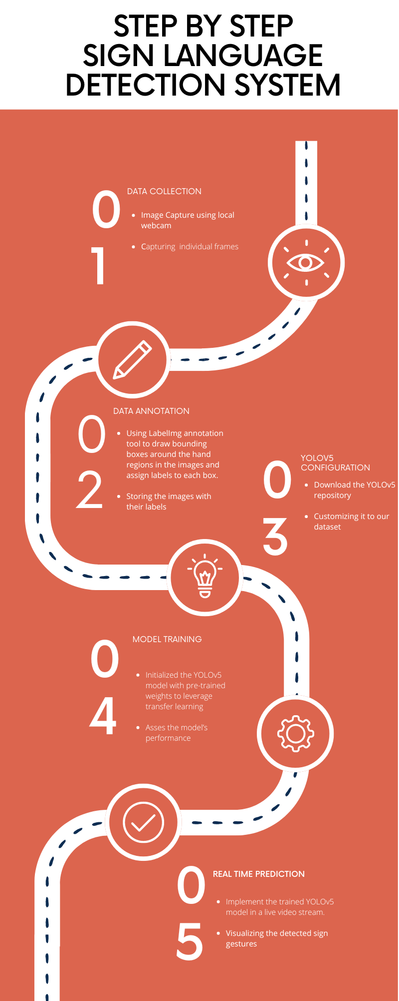

Slide 11

04
Applicability

Slide 12
Results & Applications
Accessibility
Education
Assistive Technology
Human-Computer Interaction

Slide 13


